Slide 2
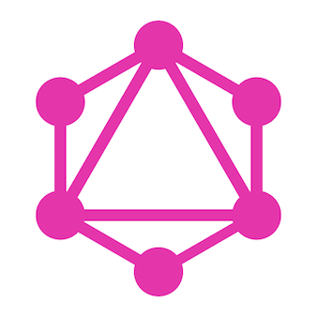
GraphQL from Js Community
Hi I’m Heithem MOUMNI

Slide 3
REST cons:
Excessive round trips — The need to do multiple round trips to fetch data required by a view
Clients dependency on servers
Overfetching — downloading unnecessary data
The biggest problem with REST APIs is the nature of multiple endpoints

Slide 4
Example
GET /ResourceName - to get a list of all the records from that resource, or
GET /ResourceName/ResourceID - to get the single record identified by that ID.
GET /ResourceName/ResourceID?columns=column1, column2 - to get the single record identified by that ID and return only column1, column2.

Slide 5

What!

Slide 6
Somewhat happy with REST until GraphQL came out

Slide 7
What is GraphQL? & Basic intro to Schemas & Queries & Mutations & Resolvers & Subscription
GraphQL

Slide 8
GraphQL is a query language for your API, and a server-side runtime for executing queries by using a type system you define for your data.
What’s GraphQL?

Slide 9
Facebook, Instagram, Meduim, Twitter, Coursera, Yelp, StackShare, PayPal, Stripe and others
Who use GraphQL?

Slide 10
- You Get exactly what you ask for The shape of the data you want is of a Graph - IDs are important - Queries look for data - Mutations look for data, expecting modification (Remember the ID) - Single endpoint
Thinking in GraphQL

Slide 11
What’s inside the box?
Schemas and
Types
Queries and
Mutations
Resolvers

Slide 12
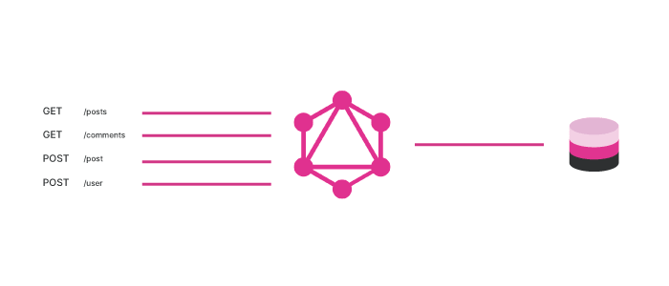
How GraphQL works
There’s no need to build a lot of endpoints! With GraphQL, we only get one endpoint, and with that, we can get as much data as we want in a single request.

Slide 13
Schemas and Types : Schemas
GraphQL has its own type of language that’s used to write schemas. This is a human-readable schema syntax called Schema Definition Language (SDL). The SDL will be the same, no matter what technology you’re using — you can use this with any language or framework that you want.

Slide 14
Schemas and Types
Types are one of the most important features of GraphQL. Types are custom objects that represent how your API is going to look. For example, if you’re building a social media application, your API should have types such as Posts, Users, Likes, Groups.
type User { id: ID! name: String! email: String! } type Posts { id: ID! title: String! content: String! }

Slide 15
Queries and Mutations: Queries
In GraphQL, Query is all about fetching for data.
type Query { users: [User!]! user(id: ID!): User! posts: [Posts!]! }

Slide 16
Queries and Mutations: Mutations
In GraphQL, mutations are the way you’re going to modify data on the server and get updated data back. You can think like the CUD (Create, Update, Delete) of REST .
type Mutation {
createUser(id:ID!, name: String!, email: String!): User!
updateUser(id:ID!, name: String!, email: String!): User!
deleteUser(id: ID!): User!
}

Slide 17
Resolvers
A function or method that resolves a value for type or field in a schema.

Slide 18
Example Resolver Query :
import {users} from './db' const resolvers = {
Query: { user: (parent, {id}, context, info) => { return users.find(user => user.id == id) }, users: (parent, args, context, info) => { return users } } }

Slide 19
Example Resolver Query :
import {users} from './db' const resolvers = { Mutation: { createUser: (parent, { id, name, email }, context, info ) => { let newUser = { id, name, email } users.push(newUser) return newUser; }, updateUser: (parent, { id, name, email }, context, info) => { let newUser = users.findIndex(user => user.id === id) newUser.name = name; newUser.email = email; return newUser } } }

Slide 20
Subscriptions
Subscriptions are a GraphQL feature that allows a server to send data to its clients when a specific event happens

Slide 21
Happy GraphQL
@MoumniHeithem
Thanks !

